Slide 1
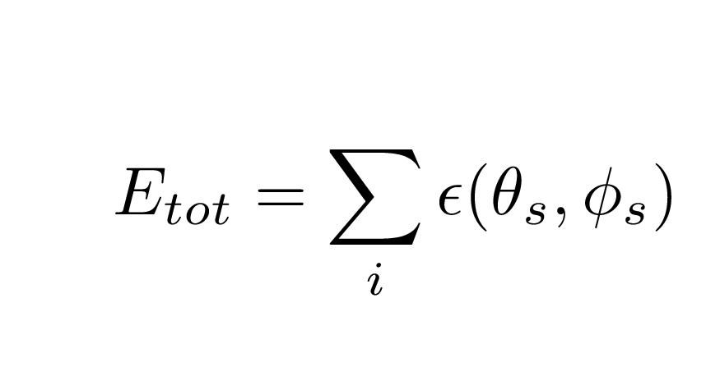
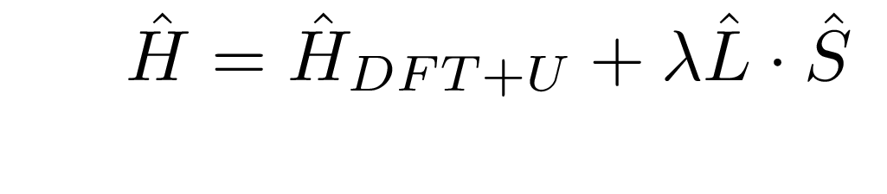
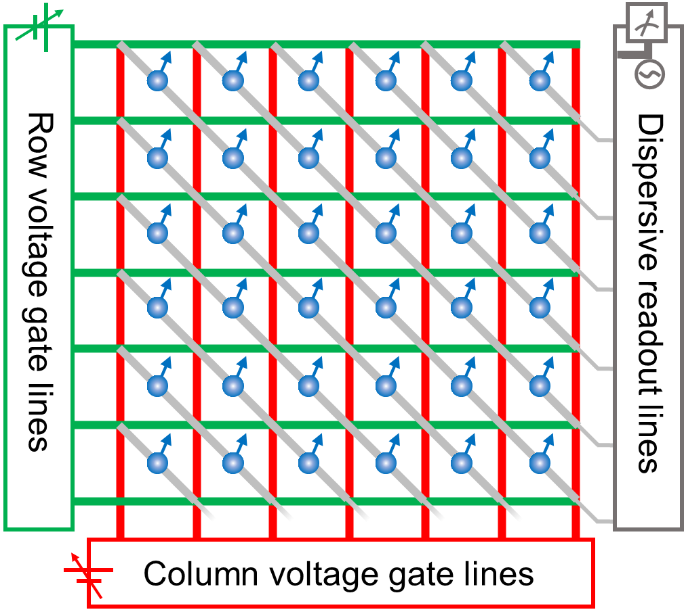
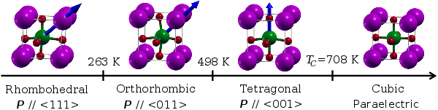
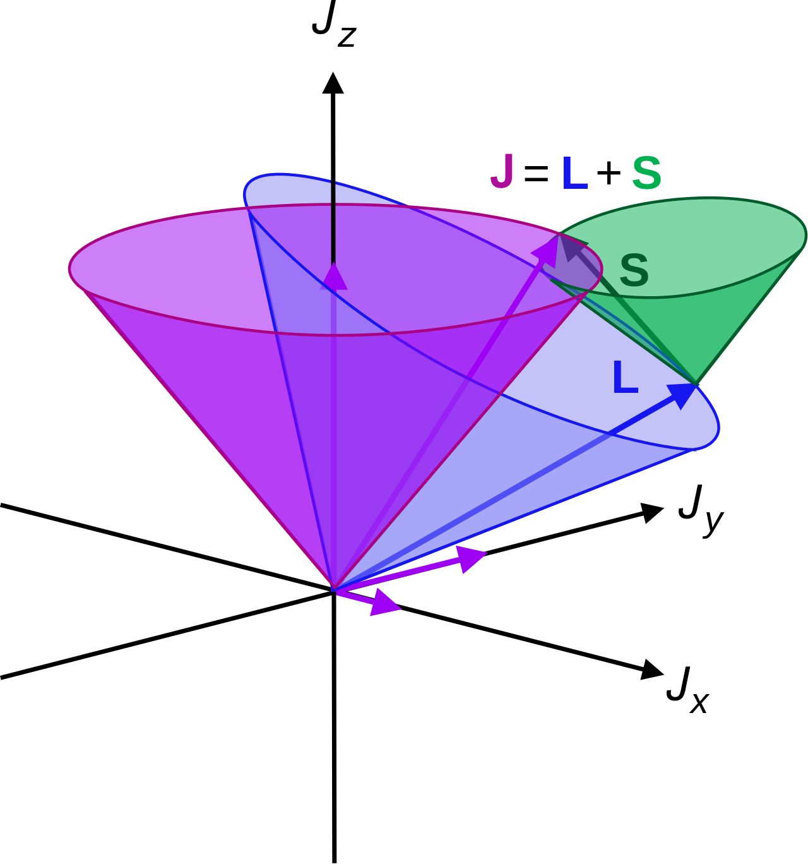
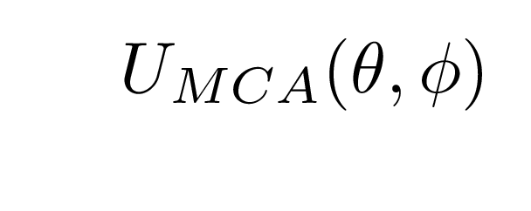
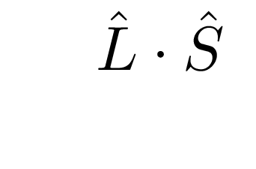
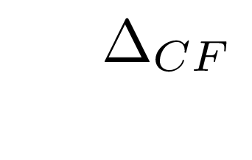
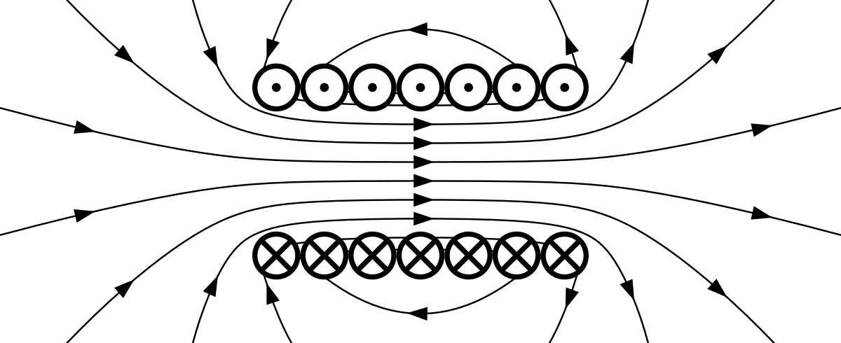

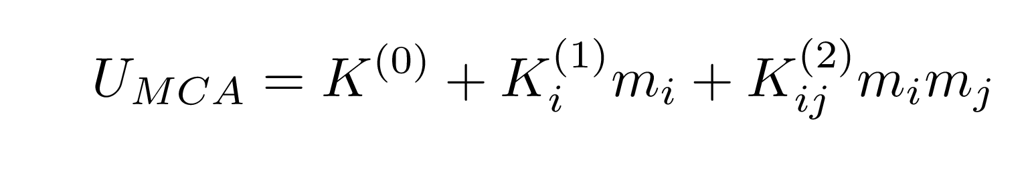
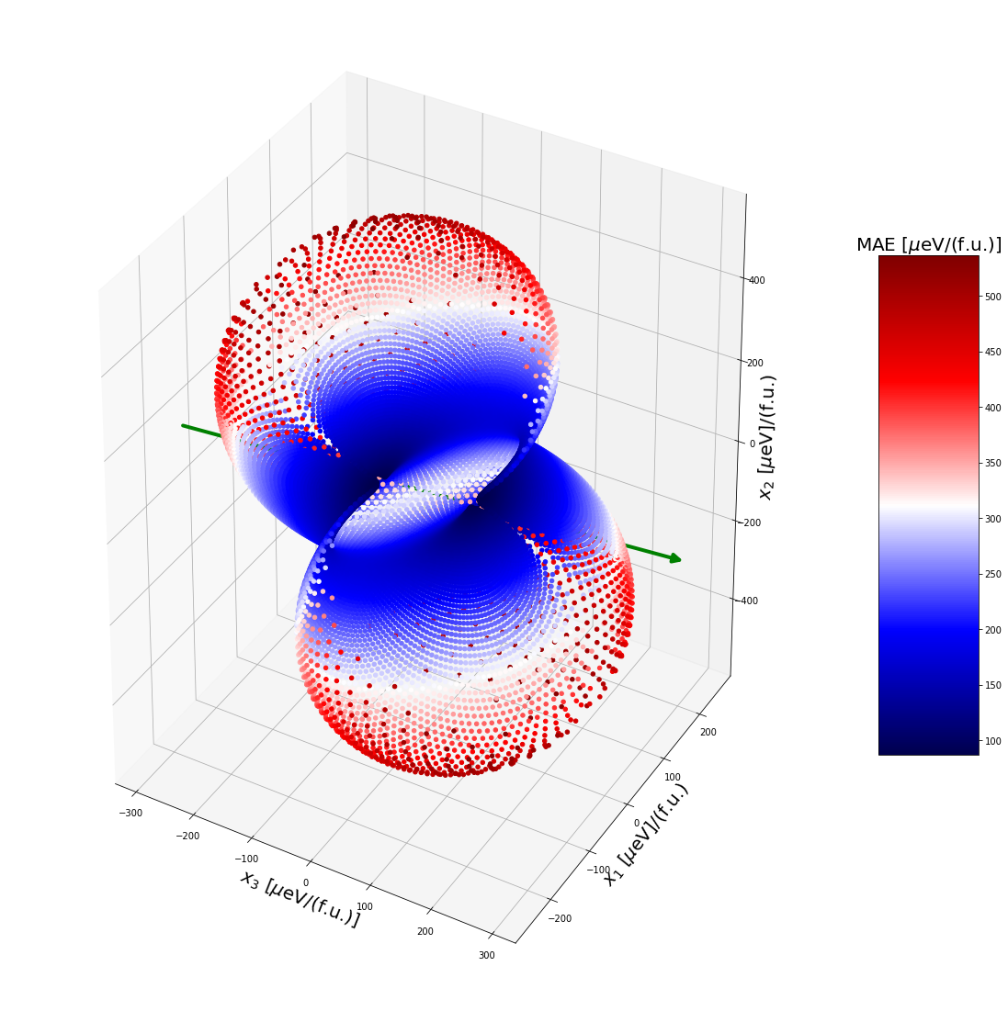
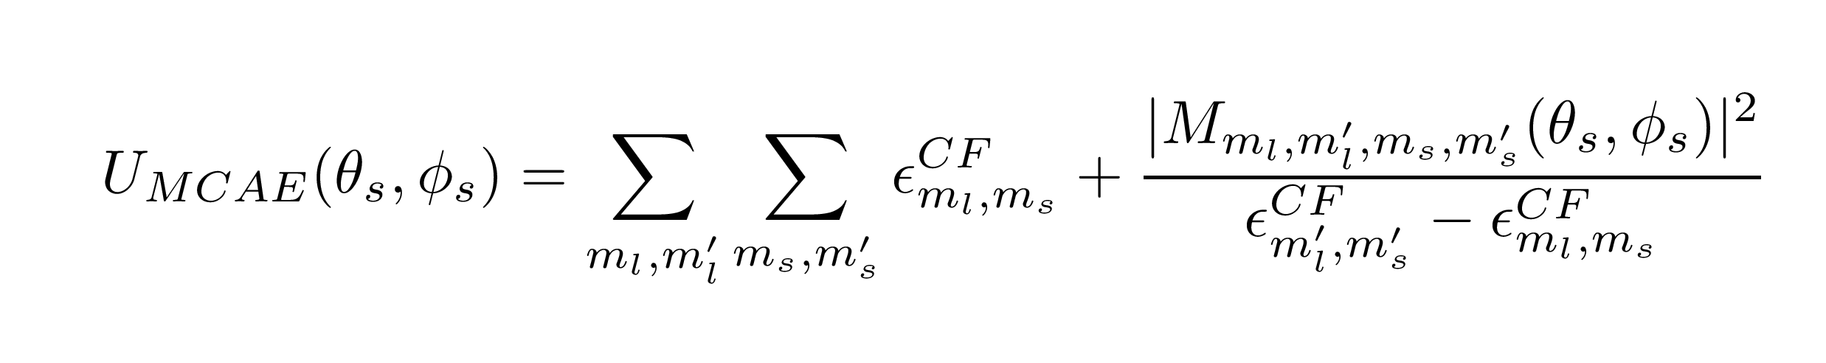
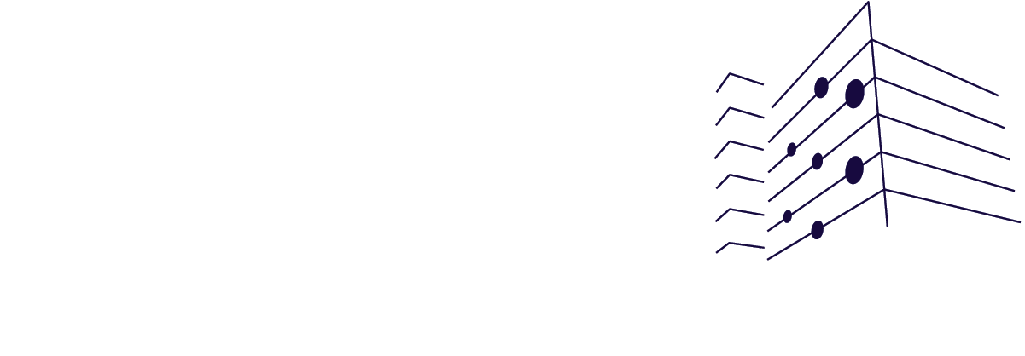


Electric field control single spins in complex oxides for energy-efficient logic
Nima Leclerc^{1, 2} , Katherine Inzani ¹, Sinéad Griffin. Email: nleclerc@lbl.gov, n475@cornell.edu
¹ Molecular Foundry, LBNL, Berkeley, CA. ¹Cornell University, Ithaca, NY.
Methods
Introduction
Problem in classical computing: Currently cannot reach Landauer limit of switching energy with complementary metal oxide (CMOS) transistors due to tunneling and other short-channel effects (e.g. drain induced barrier lowering). Threshold gate voltage at 0.5 – 1 V. Can we be more energy efficient?
(1) Select trial host oxide and dopant.
(2) Compute MCAE over grid.
Host material candidates selected based on screening criteria:
- Ferroelectric ordering
- Multi-step polarariz. switching pathway
- No magnetic ordering
SOCK (Spin Orbit Construction Kit)
Our approach: Spin oxide transistors (SOTs). Ferroelectric oxide material doped with magnetic ions. Electrostatically gated oxide layer induces polarization and drives magnetization of single dopant spin, via spin-orbit coupling. Threshold voltage ~ 150 mV. Ease of field control of single spin determined from magnetocrystalline anisotropy energy (MCAE).
Dopant candidates selected based on criteria:
- Non-zero net spin (e.g. Mn, Fe, Co)
- Distorted local crystal field environment
- Strong spin-orbit coupling with local environment
Provided the relaxed supercell from (1), MCAE over a defined spin mesh is determined via SOCK. SOCK is an opensource code we developed for prediction/analysis of MCAE surfaces. Interfaces with standard DFT codes like VASP.
(3) Determine easy axes & planes.
(4) Find mechanism. Grow & measure.
SOCK outputs MCAE for provided ‘spin’ transistor. Orientation corresponding to minimum in MCAE correspond to ‘easy axis’. MCAE surface fitted to phenomenological expression and MCAE constants are extracted.
+
?
Angular dependance of crystal field and spin-orbit coupling compared with angular dependance of MCAE, dominant mechanisms is determined. Once viable material is predicted, samples are grown by collaborators and MCAE is measured via Electron Paramagnetic Resonance Spectroscopy (EPR).
Electrostatically gate doped oxide-layer.
Electric stimulus induces ferroelectric
distortion determined by crystal field.
Polarization couples to dopant magnetic moment via spin-orbit, controlled by MCAE.
Magnetization response readout corresponding to logical ‘0’ or ‘1’.
Results
Conclusion and next steps
Bi₂WO₆ (P2₁ca)
x₃
x₂
$$\overset{⃑}{S}$$
$$\overset{⃑}{P}$$
Mn*_{Bi}
Fe***_{W}
MCAE for spin-oxide transistor depends on crystal field of the dopant atom and degree of spin-orbit coupling between dopant spin moment and its surrounding orbitals. Degree of anisotropy in the crystal field will influence the shape of the MCAE surface. Shape of engineered MCAE surface determines the how the spin transistor switches between its logical ‘0’ and ‘1’ state and its associated switching energy (threshold voltage). Our goal is to explore new candidate host materials and dopants that minimize the switching energy and to identify the dominant anisotropy mechanism.
Mn’’_{W}
Mn’’_{W}
Mn’’_{Bi}
Fe***_{W}
Fe^{x}_{Bi}

Slide 2
Introduction
Nima Leclerc, LBNL
Problem in classical computing: Currently cannot reach Landauer limit of switching energy with complementary metal oxide (CMOS) transistors due to tunneling and other short-channel effects (e.g. drain induced barrier lowering). Threshold gate voltage at 0.5 – 1 V. Can we be more energy efficient?
Our approach: Spin oxide transistors (SOTs). Ferroelectric oxide material doped with magnetic ions. Electrostatically gated oxide layer induces polarization and drives magnetization of single dopant spin, via spin-orbit coupling. Threshold voltage ~ 150 mV. Ease of field control of single spin determined from magnetocrystalline anisotropy energy (MCAE).
Electrostatically gate doped oxide-layer.
Electric stimulus induces ferroelectric
distortion determined by crystal field.
Polarization couples to dopant magnetic moment via spin-orbit, controlled by MCAE.
Magnetization response readout corresponding to logical ‘0’ or ‘1’.

Slide 3
Methods
Nima Leclerc, LBNL
(1) Select trial host oxide and dopant.
(2) Compute MCAE over grid.
Host material candidates selected based on screening criteria:
- Ferroelectric ordering
- Multi-step polarariz. switching pathway
- No magnetic ordering
SOK (Spin Orbit Kit)
Provided the relaxed supercell from (1), MCAE over a defined spin mesh is determined via SOK. SOK is an opensource code we developed for prediction/analysis of MCAE surfaces. Interfaces with standard DFT codes like VASP.
Dopant candidates selected based on criteria:
- Non-zero net spin (e.g. Mn, Fe, Co)
- Distorted local crystal field environment
- Strong spin-orbit coupling with local environment
(3) Determine easy axes & planes.
(4) Find mechanism. Grow & measure.
SOCK outputs MCAE for provided ‘spin’ transistor. Orientation corresponding to minimum in MCAE correspond to ‘easy axis’. MCAE surface fitted to phenomenological expression and MCAE constants are extracted.
+
?
Angular dependance of crystal field and spin-orbit coupling compared with angular dependance of MCAE, dominant mechanisms is determined. Once viable material is predicted, samples are grown by collaborators and MCAE is measured via Electron Paramagnetic Resonance Spectroscopy (EPR).

Slide 4

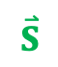
Results
Nima Leclerc, LBNL
Bi₂WO₆ (P2₁ca)
x₃
$$\overset{⃑}{S}$$
x₂
$$\overset{⃑}{P}$$
Mn*_{Bi}
Fe***_{W}
Mn’’_{W}
Mn’’_{W}
Mn’’_{Bi}
Fe***_{W}
Fe^{x}_{Bi}

Slide 5
Conclusion and next steps
Nima Leclerc, LBNL
MCAE for spin-oxide transistor depends on crystal field of the dopant atom and degree of spin-orbit coupling between dopant spin moment and its surrounding orbitals. Degree of anisotropy in the crystal field will influence the shape of the MCAE surface. Shape of engineered MCAE surface determines the how the spin transistor switches between its logical ‘0’ and ‘1’ state and its associated switching energy (threshold voltage). Our goal is to explore new candidate host materials and dopants that minimize the switching energy and to identify the dominant anisotropy mechanism.

